Slide 1
Alias IP ranges
Google Cloud alias IP ranges let you assign ranges of internal IP addresses as aliases to a virtual machine's (VM) network interfaces.
This is useful if you have multiple services running on a VM and you want to assign each service a different IP address.
Alias IP ranges also work with GKE Pods.
You can allocate alias IP ranges from that primary range, or you can add a secondary range to the subnet and allocate alias IP ranges from the secondary range.
Using IP aliasing, you can configure multiple internal IP addresses, representing containers or applications hosted in a VM, without having to define a separate network interface.

Slide 2
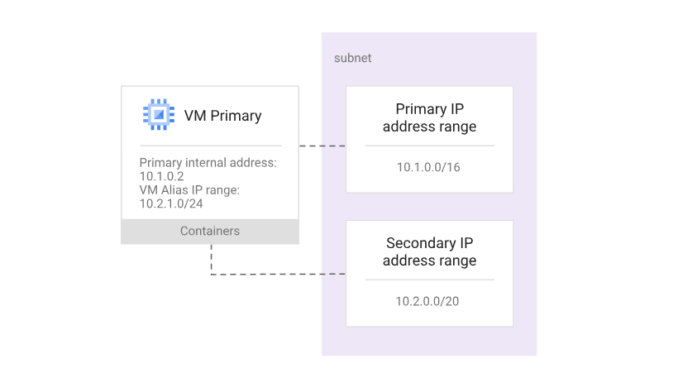
Example

Slide 3
Key Benefits
When alias IP ranges are configured, Google Cloud automatically installs Virtual Private Cloud (VPC) network routes for primary and alias IP ranges for the subnet of the primary network interface.
When container IP addresses are allocated by Google Cloud, validation processes in Google Cloud ensure that container pod IP addresses do not conflict with VM IP addresses.
Alias IP addresses can be announced by Cloud Router to an on-premises network connected via VPN or Interconnect.
There are advantages to allocating alias IP ranges from a secondary CIDR range. By allocating from a range separate from the range used for primary IP addresses, you can separate infrastructure (VMs) from services (containers).

